Slide 1

Lexical Semantics
&
Computational Semantics

Slide 2
Lexical Semantics
Semantics is the study of meanings in language. It can be applied to entire texts or to single words.
Example:
The simple word "on" can have many meanings, such as: on call, on the roof, on cloud nine, on edge, on fire, on purpose, on demand, on top, or on the phone.
Lexical Semantics: Lexical Semantics deconstruct words and phrases within a line of text to understand the meaning in terms of context.
Lexicon is mental dictionary which stores lexemes or senses or both.
Example: The word Bank can mean the side of river or can mean at money vaults.
One word bank has multiple senses.
Example: The word Dad and father may have same sense or same meaning.

Slide 3
Relations among lexemes and senses:
Homonyms that share a form but have unrelated distinct meanings.
Homonyms are generally defined as words different in meaning but either identical both in sound and spelling or identical only in sound or spelling.
Example:
Our house is on the West bank of the river
I want to save my money in the bank.
Homophones are senses that are linked to lemmas with the same pronunciation but different spellings.
A homophone is a word that is pronounced the same as another word but differs in meaning and may differ in spelling.
Example: would/ wood
too/two/to
Homographs are distinct senses linked to lemmas with the same orthographic form but different pronunciations.
Example: Articulate (Adj) Articulate (Verb)

Slide 4
Relations among lexemes and their senses
Polysemy:
Two sense of Homonym words are related.
Example:
The bank was constructed in 1875.
I with drew the money from the bank.
Are those senses are same?
Sense2: “A Financial institution
Sense1: “The building belonging to the financial institution”.
In many cases of polysemy the semantic relation between the senses is systematic and structured.

Slide 5
Relations among lexemes and their senses
Synonymy:
Words that have same meaning in one or other contexts.
Example:
Cough/sofa
Water/H20
Two lemmas are said to be synonymy if they have same proportional meanings. They can be substituted for each other in all situations.
Synonymy is the relationship between two words that have the same sense.
For example
The student speaks with a broad British accent.
The student speaks with a wide British accent.
Hence they have the same or nearly the same sense but not in the other contexts to mean the same. However this kind of sense relation means “word of the same meaning”.

Slide 6
Relations among lexemes and their senses
Antonyms
Senses which are opposite with respect to one feature of meaning.
Example: dark/light
short/long
Two kinds of Antonyms
Binary opposition/opposite ends of scale( long/short)
Reversive (rise/fall, up/down)
1. Binary antonyms come in pairs and between them exhaust all the relevant possibilities. If one is applicable, the other cannot be, and vice versa.
Example:
true – false
dead – alive
2. Reverse antonyms are two words that have a reverse relationship.
Example:
Take the words buy and sell. These words are related and have a reverse relationship. If one person buys something, another person sells something.

Slide 7
Relations among lexemes and their senses
Hypernym and Hyponymy
Word that are subset of another word are called Hyponymy.
Words that are superset of another are called Hypernym.
Sense is said to be Hyponym if the first sense is more specific, denoting a subclass of the other.
For example
Rose is hyponym of flower
Spoon is hyponym of utensil
Conversely, we say that
Flower is a hypernym of rose
Utensil is a hypernym of spoon

Slide 8
WordNet
WordNet is the lexical database i.e. dictionary for the English language, specifically designed for natural language processing.
Properties:
Synonyms are grouped together in something called Synset
A synset contains lemmas, which are the base form of a word

Slide 9
WordNet
Synset is a special kind of a simple interface that is present in NLTK to look up words in WordNet. Nouns, verbs, adjectives and adverbs are grouped into sets of cognitive synonyms (synsets).
Part of speech No. synsets
noun 82115
verb 13767
adjective 18156
adverb 3621

Slide 10
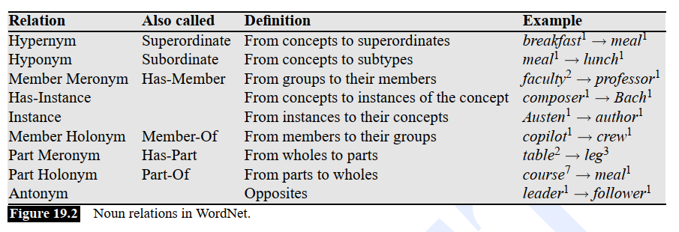

Slide 11
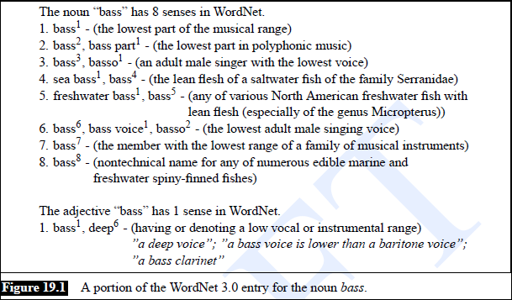

Slide 12
Semantic Analysis
Semantic analysis is the task of ensuring that the declarations and statements of a program are semantically correct i.e, that their meaning is clear and consistent with the way in which control structures and data types are supposed to be used.
Semantic Analyzer:
it can find semantic errors that occur because of the following mistakes:
Names that aren't declared
Operands of the wrong type for the operator they're used with

Slide 13
Compositional Semantics:
The meaning of the whole is made up of the meaning of its parts
  -George Cooks, Dan eats, Dan is Sick
  Cook(George) Eat(Dan) Sick (Dan)
  -If George cooks and Dan eats. Dan will get sick
  (Cook(George)^ eat (Dan)) -> Sick(Dan) Sick(Dan) -> (Cook(George)
To incorporate semantics into grammar we must have to figure out following like right representation for a single constituent based on the part of that constituent and for a category constituent based on other grammar rules making use of that constituent
e.g. Nom→ Adj Nom
And this give us a function like semantics attachments incorporated into our CFG
E.g.
Nom→ Adj Nom{λx Nom.sem(x)^lsa(x,Adj.sem)}

Slide 14
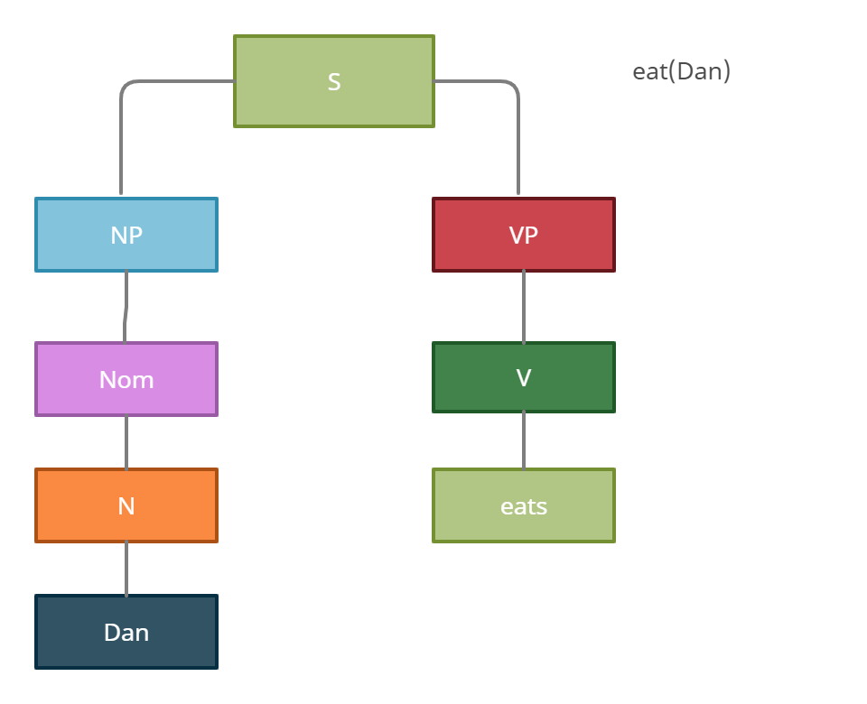
Syntax- Driven Semantics

Slide 15
What do we do with them?
As we did with feature structure:
alter an early-style parser so when
constituents are completed the attached
semantic function applied and meaning
representation created and stored with state
And let parser run to completion and then walk through resulting tree running semantic attachments from bottom-up

Slide 16
Example
AyCaramba serves meat
Associating Constants with constituents
  - ProperNoun -> AyCaramba { AyCaramba}
  - MassNoun -> meat {Meat}
Defining function to produce this from input
  - NP -> ProperNoun {properNoun.sem}
  - NP -> MassNoun{MassNoun.sem}
  -Assumption: meaning reps of children are passed up to the parents for non branching constuents
Verb here are action

Slide 17
  - V-> serves {E(e,x,y) Isa(e Serving) ^ Server(e,x) ^ Served(e,y)}
  - Will every verb have its own distinct representation?
  - Predicate(Agent, Patient)
How do we combine these Pieces?
  - VP -> V NP
  - Goal : E(e,x) Isa(e, Serving) ^Server(e,x) ^ Served(e, Meat)
-VP semantics must tell us
  Which vars to be replaced by which args
  How this replacement is done

Slide 18
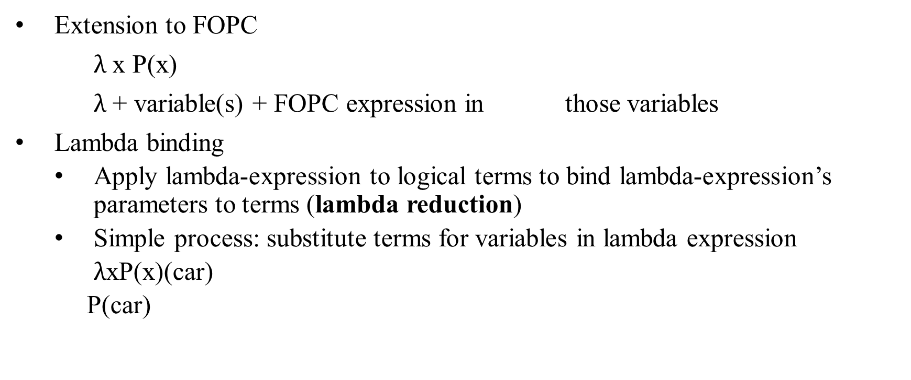
Lambda Notation
Extension to FOPC
$λ$ x P(x)
$λ$ + variable(s) + FOPC expression in those variables
Lambda binding
  Apply lambda-expression to logical terms to bind lambda-expression’s parameters to terms (lambda reduction)
  Simple process: substitute terms for variables in lambda expression
  $λ$xP(x)(car)
  P(car)

Slide 19
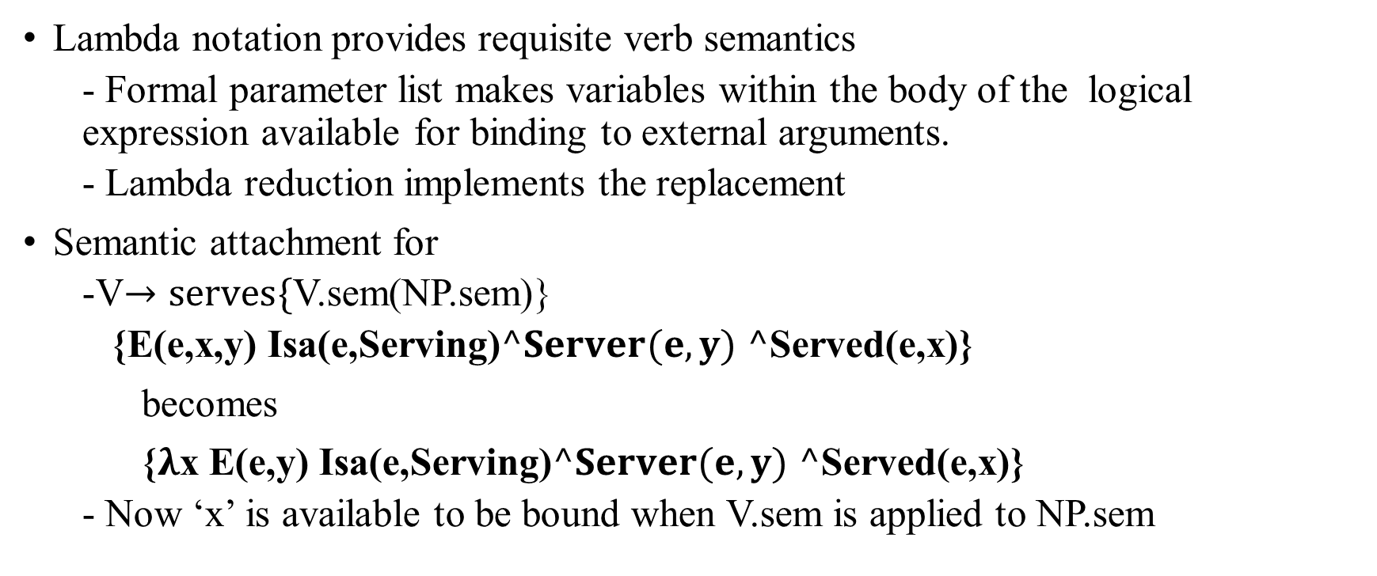
Cont…
Lambda notation provides requisite verb semantics
  - Formal parameter list makes variables within the body of the logical expression available for binding to external arguments.
  - Lambda reduction implements the replacement
Semantic attachment for
  -V$→serves\{$V.sem(NP.sem)}
  {E(e,x,y) Isa(e,Serving)$^Server(e,y)$ $^$Served(e,x)}
becomes
{$λ$x E(e,y) Isa(e,Serving)$^Server(e,y)$ $^$Served(e,x)}
  - Now ‘x’ is available to be bound when V.sem is applied to NP.sem

Slide 20
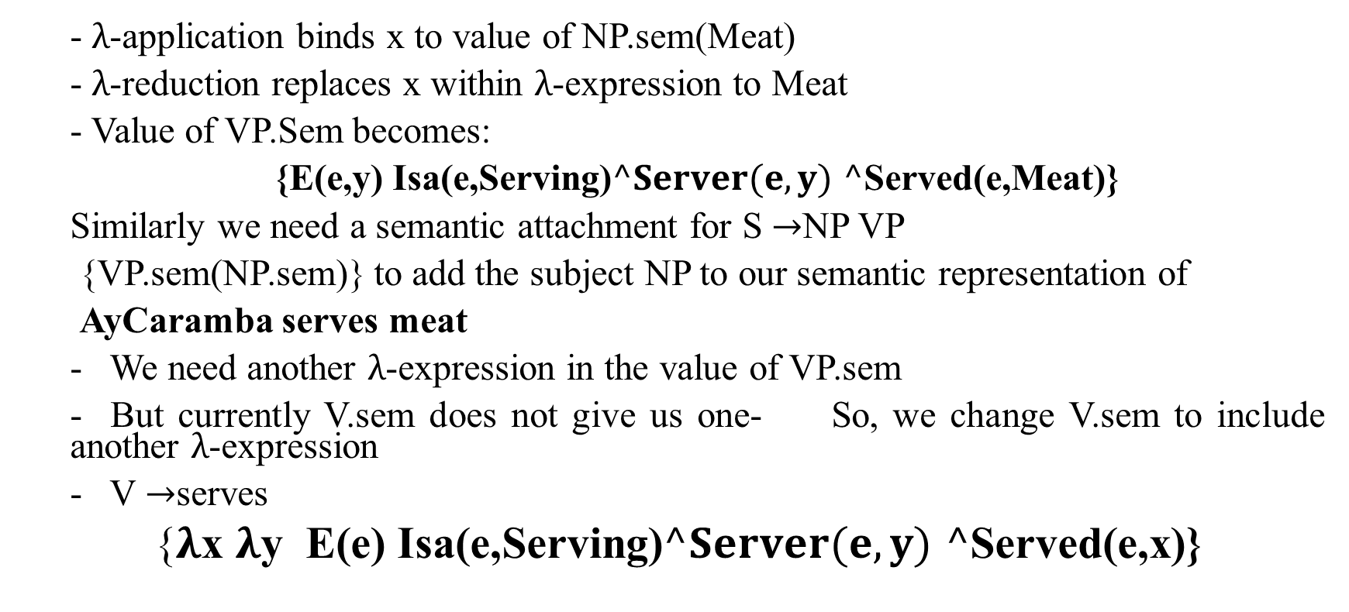
Cont…
  - $λ$-application binds x to value of NP.sem(Meat)
  - $λ$-reduction replaces x within $λ$-expression to Meat
  - Value of VP.Sem becomes:
  {E(e,y) Isa(e,Serving)$^Server(e,y)$ $^$Served(e,Meat)}
  Similarly we need a semantic attachment for S $→$NP VP
  {VP.sem(NP.sem)} to add the subject NP to our semantic representation of
  AyCaramba serves meat
  - We need another $λ$-expression in the value of VP.sem
  - But currently V.sem does not give us one- So, we change V.sem to include another $λ$-expression
  - V $→$serves
  {$λ$x $λ$y E(e) Isa(e,Serving)$^Server(e,y)$ $^$Served(e,x)}

Slide 21

Cont…
VP semantics(V.sem(NP.sem) binds the outer $λ$-expression to the object NP (Meat) but leaves the inner $λ$-expression for subsequent binding to the subject NP when the semantics of S is determined :
  {E(e)Isa(e,Serving)$^Server(e,AyCaramba)^$Served(e,Meat)}

Slide 22
Option1 (Integrated Semantics Analysis)
S -> NP VP {VP.sem(NP.sem)}
- VP. Sem has been stored in stats representing VP
- Np.sem stored with the state for NP
- When rule completed, go get value of VP.sem, go get NP.sem, and
apply VP.sem to NP. Sem
- Store result in S.sem
As fragments of input parsed, Semantic fragmented created
Can be used to block ambiguous representation

Slide 23
NON- Compositional Language
What we do with language whose meaning is not derive from the meaning of its parts
-Metaphor: You are the cream in my Coffee
- She’s the cream in George’s coffee
- The break-in was just the tip of the iceberg
- This was only the tip of Shirley’s iceberg
- Idioms: The old man Finally kicked the bucket.
-The old man finally kicked the proverbial bucket
Solution?
- Mix lexical item with special grammar rules?

Slide 24
Semantic Attachments
The attachments can be thought of as instructions that specify way to compute the meaning representation of a construction from the meanings of its constituents parts.
The notation of semantic attachments states that the meaning representation assigned to a construction.

Slide 25
Sentences
  This section expands our coverage to include the other sentence types. Let’s start by considering the following examples:
  Flight 487 serves lunch.
  Serve lunch.
  Does flight 207 serve lunch?
  Which flights serve lunch?
  Declarative sentences:
  We can simply alter the basic sentence rule :
  S-> NP VP { DCL(Vp.sem(NP.sem))} ∴ DCL is an operator
  Imperative Sentences:
  It begins with a verb phrase and lack an overt subject.
  S-> VP {IMP(VP.sem(Dummy You))} ∴ IMP is an operator

Slide 26
Sentences(Cont...)
Yes or no Questions:
Yes-no-questions consist of a sentence initial auxiliary verb, followed by a subject noun phrase and verb phrase.
The following asemantic attachment simply ignores the auxiliary and with the exception of the YNQ operator, constructs the same representation that would created for the corresponding declarative sentence.
S-> Aux NP VP { YNQ(VP.sem(NP.sem))}
Wh-Subject-questions:
Wh-subject-questions ask for specific information about the subject of the sentence rather than the sentence as a whole.
S-> Wh Word NP VP { WHQ(NP.sem,var,VP.sem(NP.sem)))}
WHQ is an operator and we can add variable x tells that what type of question it is.

Slide 27
2. Noun Phrases
Compound Nominals: Compound Nominals also known as noun-noun sequences consist of simple sequences of nouns .
Example:
Flight schedule
Summer flight schedule
Both sentences contain only the nouns. The word schedule is taken as a head of the noun and remaining noun denoted as NN.
  λx.Schedule(x) ∧ NN(x,Flight)
  λx.Schedule(x)∧NN(x,Flight)∧NN(x,Summer)

Slide 28
2. Noun Phrases
Genitive Noun Phrases Genitive Noun Phrases make use of complex determiners that consist of noun phrases with possessive markers, as in ‘Atlanta’s airport’ and ‘Maharani’s menu’.
NP → ComplexDet Nominal
{<∃xNominal.sem(x)∧GN(x,ComplexDet.sem)>}
Applying these rules to Atlanta’s airport results in the following complex-term:
< ∃xIsa(x,Airport)∧GN(x,Atlanta) >

Slide 29
3.Verb Phrases
λ-expression attached to the verb is simply applied to the semantic attachments of the verb’s arguments.
Infinitive Verb Phrases :
I told Harry to go to Maharani.
The meaning representation for this example should be something like the following:
∃e,f,xIsa(e,Telling)∧Isa(f,Going)∧Teller(e,Speaker)∧Tellee(e,Harry)∧ToldThing(e, f) ∧Goer(f,Harry)∧Destination(f,x)

Slide 30
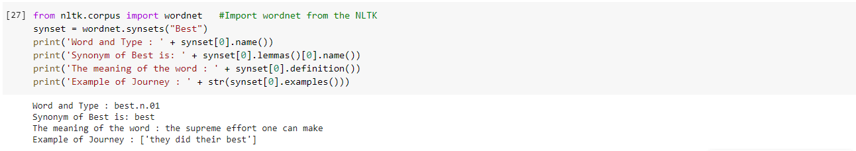
Implementation
Meaning and Synonym

Slide 31
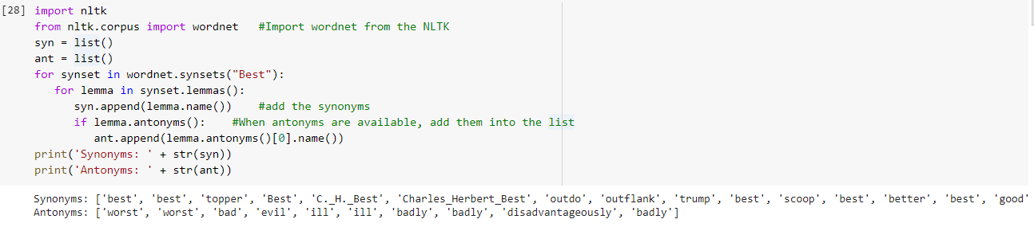
Synonyms And Antonyms

Slide 32
Summing Up
Principle of Compositionality
Semantics of NL sentences and phrases can be composed from the semantics of their subparts
Rules can be derived which map syntactic analysis to semantic representation (Rule to Rule Hypothesis)
  Lambda notation provides a way to extend FOPC to this end
  But coming up with rule to rule mappings is hard
Wordnet is a large database of lexical relation for English words

